Slide 1
RTM A New Real-Time Messaging Middleware -- A Transport Protocol For RTM
Washington University
Project Report
Oct. 20, 2016

Slide 2
Outline
Connections in RTM
Design Goal
Existing Protocols or Solutions
TCP vs. UDP Performance
Experiment Setup
One-to-one Connection
Fan-out Model
Fan-in Model
Proposal
Approach: Reliable Multicast UDP

Slide 3
Connections in RTM
Connections with Lookup Daemon
Publisher and Lookup Daemon
One-time connection, exchange setup information
Subscriber and Lookup Daemon
One-time connection, exchange setup information
RTM Daemon and Lookup Daemon
Persistent connection, setup and update configuration information
Connection characteristics
Low concurrency, either one-time connection or limited number of persistent connections (only 10s of RTM daemons)
Low traffic, not much information is exchanged.
TCP is a good enough since it’s already highly optimized and provides reliability and retransmission.

Slide 4
Connections in RTM (cont.)
Connections with RTM Daemon
Publishers and RTM Daemon
Persistent connection, 100s of publishers send messages to Daemon and Daemon sends back message acks
RTM Daemon and Subscribers
Persistent connection, daemon sends messages to subscribers (up to 1000s), and subscribers send back message acks
Connection characteristics
High concurrency, one-to-many message transmission or many-to-one message transmission
Experiments identified scenarios with potential for high latency for connections between RTM Daemon and subscribers
Main scalability problem: 1000s of subscribers
Transport protocol should be scalable and able to handle high transmission concurrency

Slide 5
Design Goal
Transport protocol For RTM
Performance
Minimize per message latency between daemon and subscriber
Preserve high message throughput
Minimize CPU consumption
Scalability
Ability to scale to 1000s concurrent connections
Reliability
Reliable delivery of messages (either through transport or application level reliability)
In-order message delivery optional, since in-order hurts latency when message loss happens.

Slide 6
Existing Protocols or Solutions
TCP
Widely used and highly optimized in current network stack
Already provides reliability and high throughput
But does not guarantee latency
Variations or improvements based on TCP
Reduce blocking latency with smart framing [1]
Low-latency Adaptive Streaming [2]
UDP
Datagram, light weight transport protocol
UDP based Reliable Transport Protocol
UDT: reliable data transfer for high-speed wide area network [3]
Aeron: reliable and low latency UDP messaging system [4]
Efficient network stack for multicore environment
mTCP: user-space stack [5]
Megapipe: scalable network I/O [6]
Fastsocket: highly scalable socket for multicore [7]

Slide 7
Existing Protocols or Solutions (cont.)
Comments on Current Solutions
Most works focus on improving throughput rather than reducing latency, and may therefore be unsuitable for the latter (e.g., batching hurts latency).
Most UDP and TCP extensions (except for multicore extensions) are ~10 years old, and ignore many TCP stack and NIC optimizations undertaken over the years.
None of the UDP and TCP extensions aims to address scalability or high concurrency.
We first need to
Benchmark the performance of TCP and UDP in the current Linux Kernel.
Evaluate differences introduced by go language, since our RTM is based on NSQ which is written in go.
Emulate the RTM scenarios for Fan-in and Fan-out, and then do a comparative evaluation of the latency with TCP and UDP (which indicates the relative performance of TCP and UDP)

Slide 8
TCP vs. UDP Performance
Benchmark TCP and UDP performance for one-to-one connection
Linux kernel raw performance
For this part, we intend to measure and explore the performance and limitation of TCP and UDP in Linux kernel
Write C program that directly calls sys calls to measure the performance of Linux kernel for TCP and UDP
Go language interface performance
Go language wraps socket related sys calls, and it also uses goroutines for scheduling. All may affect the performance. We intend to evaluate the performance and compare it with Linux kernel performance.
Write program with Go language calling Go net interface
Benchmark the relative performance of TCP and UDP in RTM scenarios
Write programs with Go language to emulate two RTM scenarios for Daemon and subscriber connection.
Fan-in model: Messages from multiple sources are aggregated and sent through one connection
Fan-out model: Messages from single source are sent to multiple connections
Notes:
Emulating with golang for simulation

Slide 9
Experimental Setup
Configurations
Two servers from Huawei, (s1 and s2)
CPU Intel(R) Xeon(R) CPU E5-2660 with 40 cores, 126 GB memory
OS: CentOS Linux release 7.2.1511, kernel version: 3.10.0-327.28.3.el7.x86_64
Only 2 cores are used in Fan-in and Fan-out scenarios, to create CPU contention with relatively small number of connections (RTM Daemon runs in a CPU contention environment).
Tuning for TCP and UDP
TCP socket with TCP_NODELAY option to disable Nagle’s algorithm, send small packets immediately to minimize latency
UDP send/receive buffer set to 4MB to avoid losses
See document “Tuning document” for additional parameter tunings for performance in 10G/100G.

Slide 10
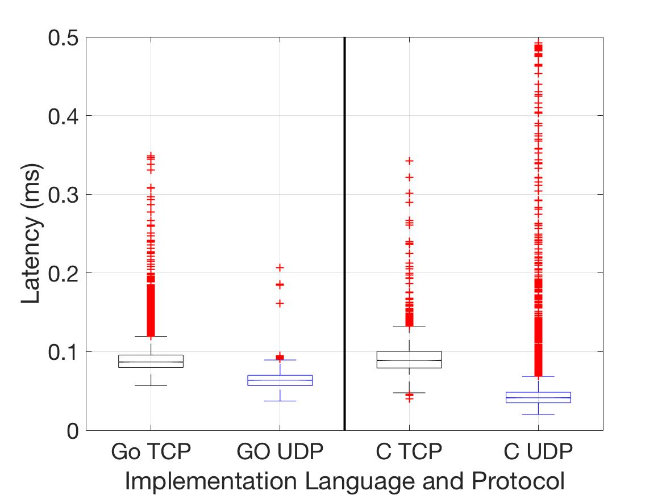
One-to-One Connection
Benchmark TCP and UDP performance
Sender (with single thread/go routine) keeps sending 1000 bytes packets in a for loop without wait or sleep.
Result:
Go language net interface introduces overheads (due to extra function calls) which affects the throughput for both TCP and UDP (especially for UDP).
The latencies for TCP and UDP are quite close for Go and C.
For both GO and C, the latency of TCP is slightly higher than UDP, but its throughput is much higher than UDP, since TCP can batch multiple messages and improve throughput.

Slide 11
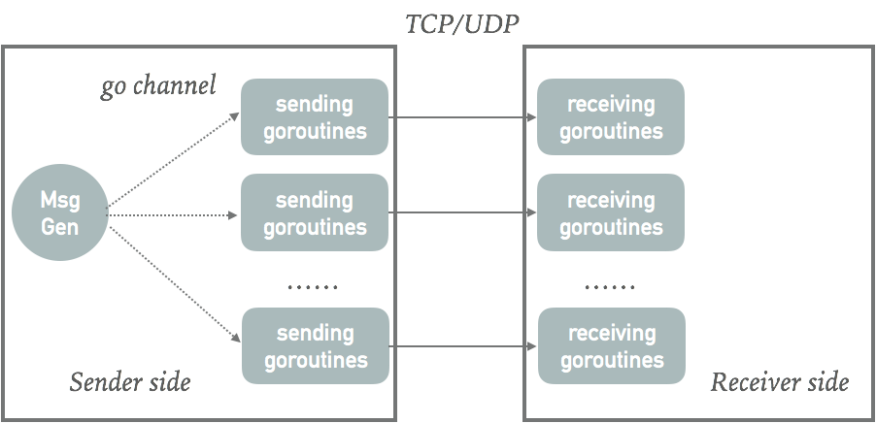
Fan-out
Setup
Sender and receiver run on two different machines (Huawei S1 and S2).
One message generation goroutine at sender side generates signal sending to each sending goroutine every 5ms which triggers the sending goroutine sending a 1000bytes message.
Multiple connections between sender side and receiver side , each connection is handled by one goroutine at teach side.

Slide 12
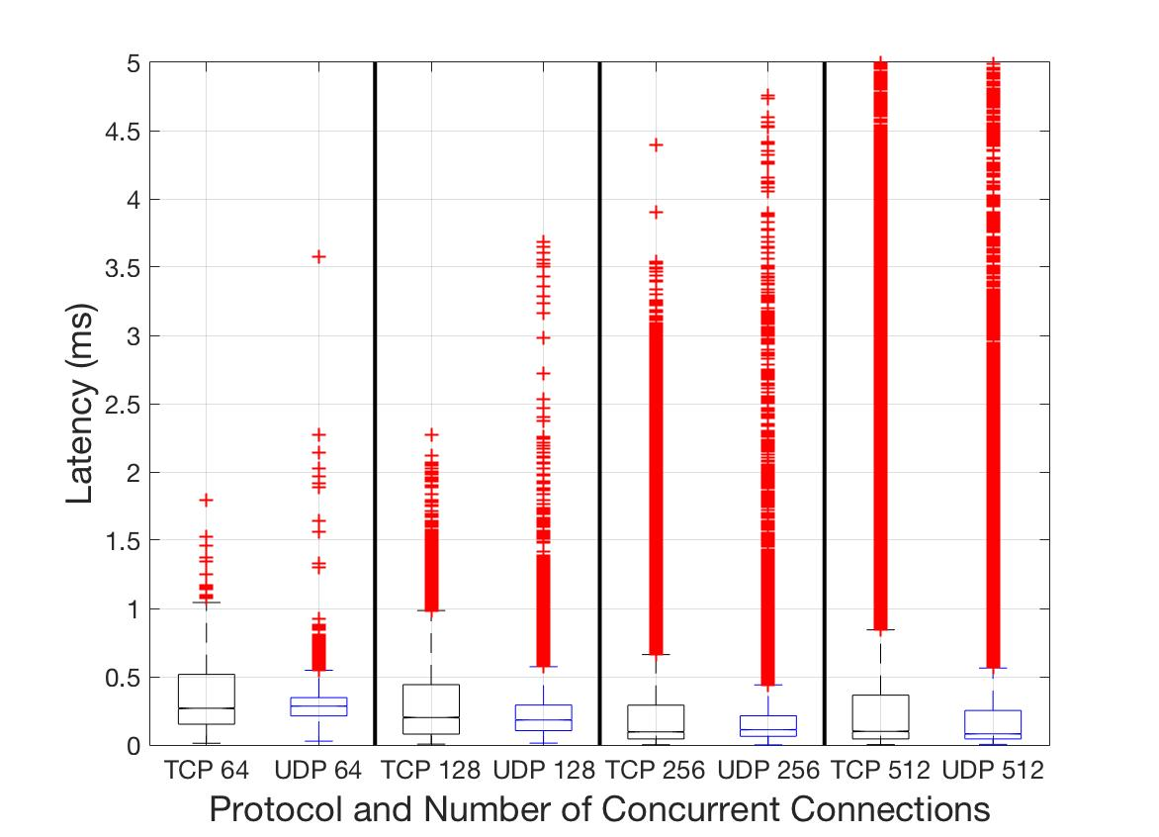
Fan-out (cont.)
Results
For both protocols, the average latency increases as #of concurrent connections increases (due to more outliers with longer latency caused by concurrency).
The average latency for TCP is slightly worse than UDP, the difference is not that significant. Socket difference is not the major bottleneck here.
TCP has slightly higher user and system CPU utilization than UDP for most cases, since TCP socket is more complicated than UDP socket.
However, when # of concurrent connections is 512, UDP has higher user and system CPU utilization, could be that the overhead of UDP in go net interface starts to play a role.

Slide 13
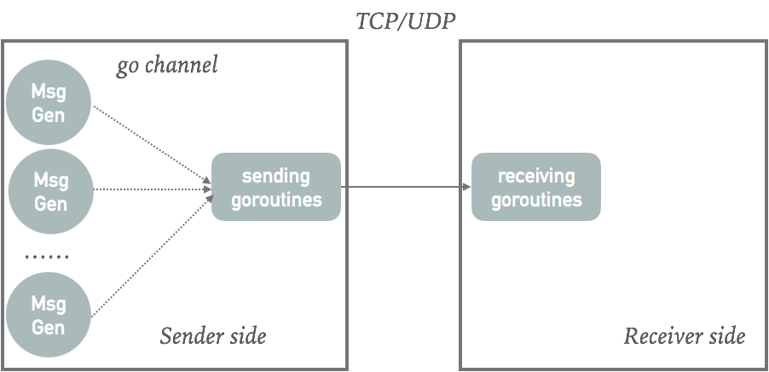
Fan-in
Setup
Sender and receiver run on two different machines (Huawei S1 and S2).
Multiple message generation goroutines at sender side, each generates signal sending to the sending goroutine every 5ms which triggers the sending goroutine sending a 1000bytes message.
Only one connection between sender and receiver, which is handled by the sending goroutine at the sender side and receiving goroutine at the receiver side.

Slide 14
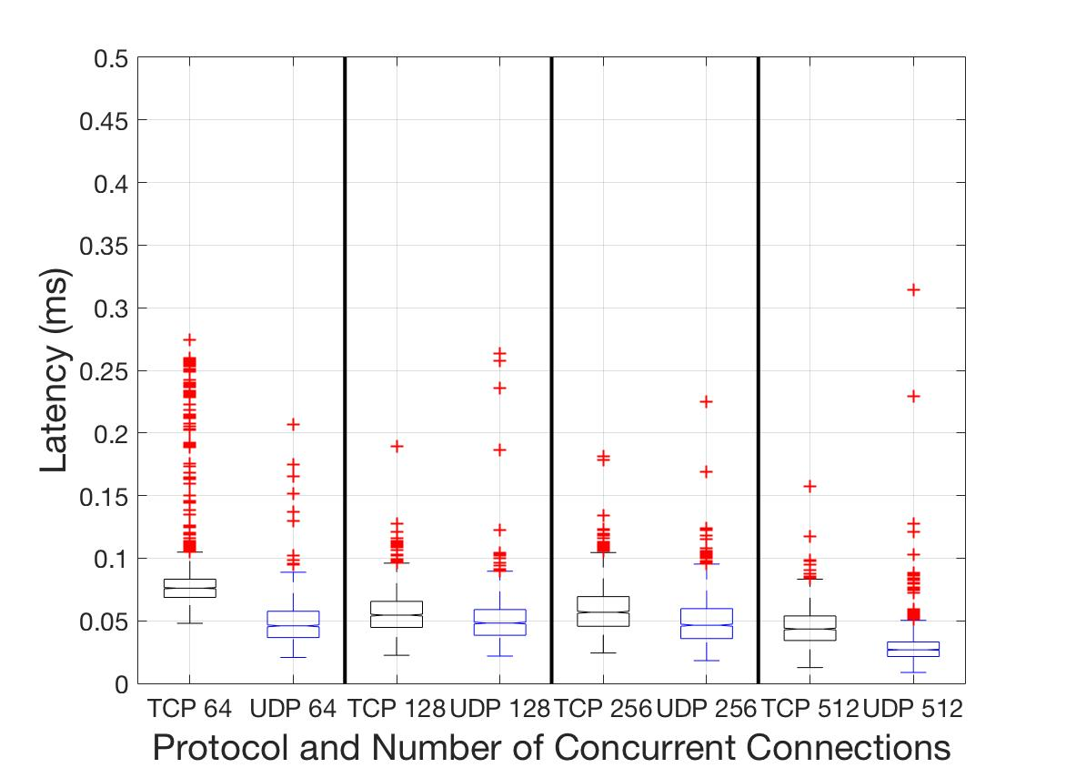
Fan-in (cont.)
Results
Latencies for both UDP and TCP are small, less than 0.1 ms.
TCP has slightly higher latency than UDP which is consistent with one-to-one connection experiment.
Latency for both protocols decreases as aggregated traffic increases (# of messages increases), could be that the impact of NAPI, where it’s more efficient with larger load of traffic.
The CPU utilization are close for TCP and UDP. However, UDP has slightly higher user and system CPU utilization than TCP , since TCP can batch messages and therefore reduces # of sent packets.
Notes:
y axis start from 0.
explain the result more sightfully.

Slide 15
Proposal
Conclusion from Experiment Results
There’s no significant advantage of UDP over TCP in latency, especially when connection concurrency is high.
For both TCP and UDP, they have significantly higher latency in high-concurrency scenario.
Proposed approach
Build Reliable UDP Multicast solution (RM-UDP)
Multicast reduces concurrency for Daemon, allowing Daemon to connect to multiple Subscribers with only one socket.
Reliability is needed to recover from packet loss.
Either at application or transport level
Measure the performance of RM-UDP under different scenarios (e.g., for subscribers with high loss rate connection)
If RM-UDP is inadequate for some cases, like subscribers have a high loss rate, we can explore another extension - Hybrid multicast-unicast option where
Some Subscribers connect to RM-UDP Daemon.
Some Subscribers connect to unicast TCP Daemon.

Slide 16
Multicast For Distributed System
Requirements for multicast protocol
Well supported by routers
Suit for the RTM application
Subscribers can join and leave the multicast group any time.
Suit for distributed implementation of RTM
Publishers of the same topic can be connected to multiple Daemons, each Daemons connects to the same set of Subscribers.
Multiple nodes can send multicast within one multicast group.
PIM SM (Protocol Independent Multicast Sparse Mode)
Widely supported by most routers and systems.
Each node (either Daemon or Subscriber) can join and leave the multicast group.
All the nodes can perform multicast within one multicast group, therefore all Daemons forwarding the same topic can multicast the messages within the same multicast group.

Slide 17
Reliable UDP Multicast
Reliable UDP Multicast with PIM SM
Enable end-to-end message reliable delivery.
Dramatically reduces the complexity (socket numbers) in both Daemon and Subscriber side.
Support for distributed implementation of RTM.
Setup for Daemon and Subscriber Connection:
For each topic creates one multicast group using one multicast address in 224.0.0.0/4.
Daemon: join a multicast group for each topic.
Subscriber: join a multicast group for each topic.
Work scope:
Change the message sending and receiving part of RTM Daemon and Subscriber.
Add reliability mechanisms: sending window, ack or nack, retransmission & so on.

Slide 18
Reference
[1] M. Mellia, M. Meo, and C. Casetti, “TCP smart framing: a segmentation algorithm to reduce TCP latency,” IEEE/ACM Transactions on Networking (TON), vol. 13, no. 2, pp. 316–329, 2005.
[2] A. Goel, C. Krasic, and J. Walpole, “Low-latency adaptive streaming over tcp,” ACM Transactions on Multimedia Computing, Communications, and Applications (TOMM), vol. 4, no. 3, pp. 20–20, Aug. 2008.
[3] Y. Gu and R. L. Grossman, “UDT: UDP-based data transfer for high-speed wide area networks,” Computer Networks, vol. 51, no. 7, pp. 1777–1799, May 2007.
[4] “Aeron - Efficient reliable UDP unicast, UDP multicast, and IPC message transport.” [Online]. Available: https://github.com/real-logic/Aeron. [Accessed: 15-Oct-2016].
[5] E. Jeong, S. Woo, M. Jamshed, H. Jeong, and S. Ihm, “mTCP: a highly scalable user-level TCP stack for multicore systems,” USENIX NSDI, 2014.
[6] S. Han, S. Marshall, and B. G. Chun, “MegaPipe: A New Programming Interface for Scalable Network I/O | USENIX,” USENIX OSDI, 2012.
[7] “Fastsocket.” [Online]. Available: https://github.com/fastos/fastsocket. [Accessed: 15-Oct-2016].

